Slide 1

Real-Time Video Analytics for Integrated Traffic Monitoring, Management, and Pollution Assessment
Team – Appaji, Suswarah, Rubi, Suneetha

Slide 2
About me
Background
MSc Mathematics from Andhra University
Reason
To apply my mathematical skills and analytical mindset. To explore new career opportunities.
Work Experience
Software Engineer (Senior Content Developer)

Slide 3
Project Overview
PS-1
AI-Based Automatic Vehicle Parking Assistance
PS-2
Monitoring the Traffic across different live cameras
PS-3
Measuring Pollution Based on Vehicle Count

Slide 4
Prerequisites
Colab For Model Training (Object Detector and Machine Learning)
VS Code Develop and run production code
Environment Setup For code execution
Python Programming language
OpenCV Plot bounding boxes, labels
Argparse Automate code, create pipelines

Slide 5
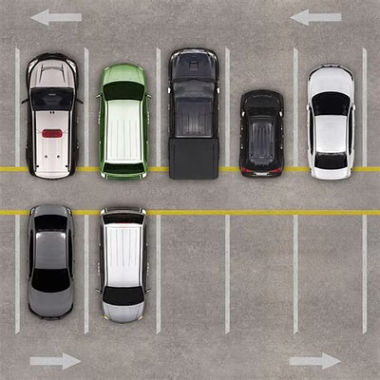
Problem Statement 1
Develop AI for automatic vehicle parking assistance.
Detect available parking spaces using Object Detector and cameras.
Provide real-time information on parking space availability.

Slide 6
To-Do List
Object Detector
ROI (Region of Interest)
Counting Algorithm based on Object Detector
Videos for Testing

Slide 7
Approach
Data Collection: Gather and augment data
Model Training: Train YOLOv8n model
ROI Implementation: Test model within defined regions

Slide 8
Model Training Process
Dataset Stats
Model Training
Model: YOLOv8n
Epochs: 50
Model Validation
Load custom trained model
Metrics: MAP
Image size: 640
Optimizer: AdamW
Test : 123
Validation: 237
Training: 1655

Slide 9
Code Implementation
Import necessary libraries
Initialize reference points and mouse callback for ROI selection.
Define function to check bounding box intersection with ROI.
Process frames to detect objects within ROI.
Main function to load model, capture video, and process frames.
Draw ROI, count parking spaces, and display results on video

Slide 10
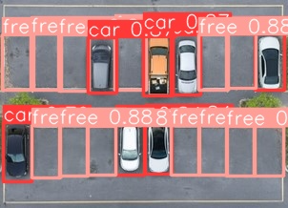
Output Image
Bounding Boxes
Red: No car in region
Green: Car in region

Slide 11
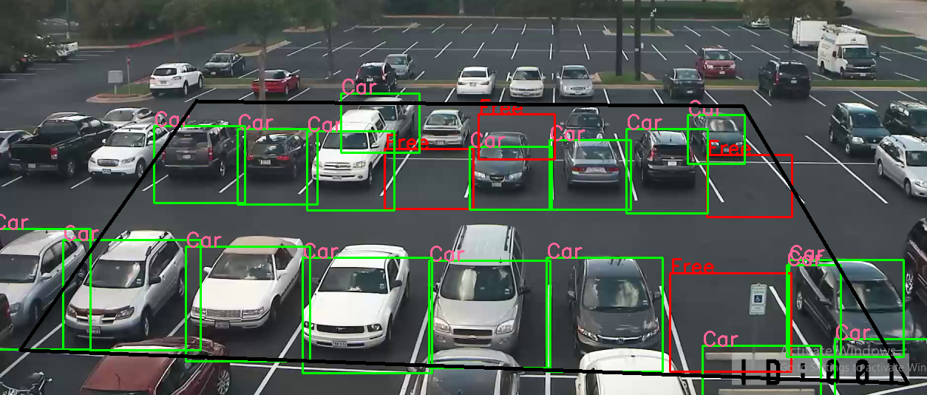
Output Video

Slide 12
Problem Statement 2: Traffic Monitoring System
Create a traffic monitoring system that utilizes Object Detector and
live camera
Problem Statement 3: Pollution Measurement System
Design a solution that estimates pollution levels based on the
number and type of vehicles in a given area.

Slide 13
Approach for PS-2
Utilize Object Detector to analyze live or pre-recorded videos
Implement an object counting algorithm
Display the number of vehicles traveling in a given video
Output
Real-time traffic count

Slide 14
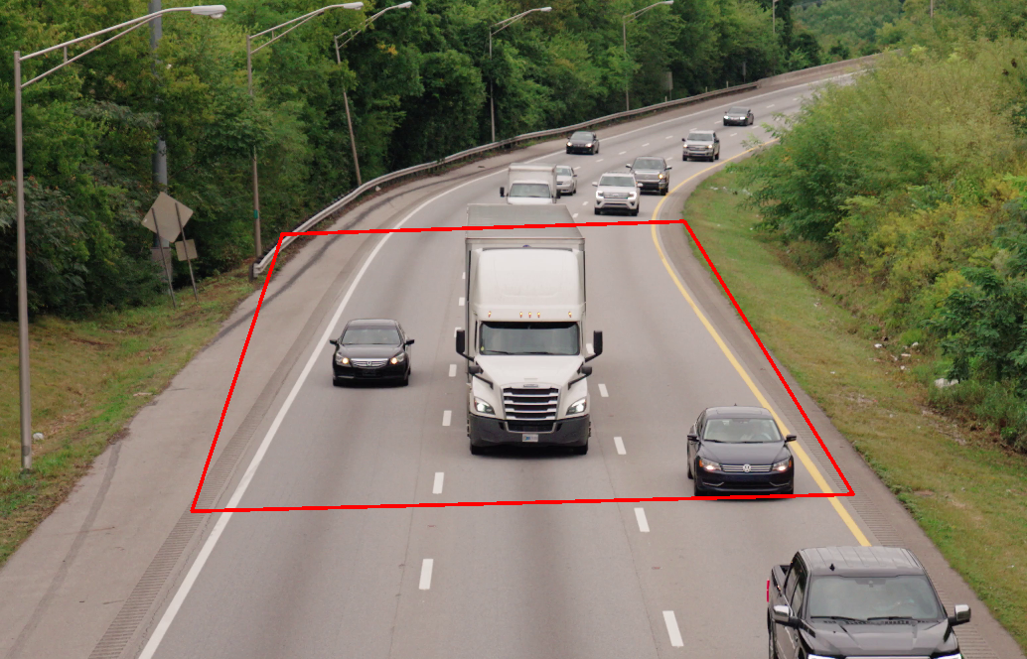
Drawing ROI

Slide 15
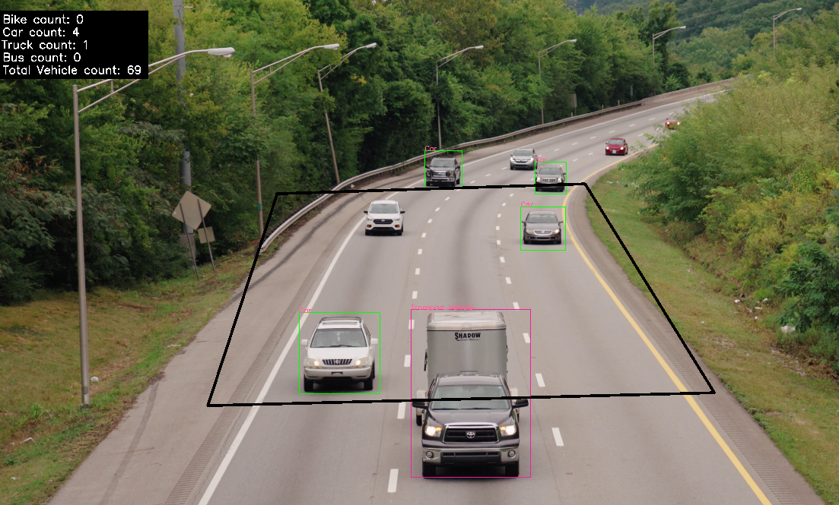
PS2 - Output
The system displays
real-time vehicle
counts on the video,
providing real-time
traffic data for each
vehicle type.

Slide 16
Approach for PS-3
Use Object Detector to analyze live traffic data
Find dataset with pollution details for different vehicles
Build an ML model for pollution prediction
Output
Real-time pollution estimates displayed on video

Slide 17
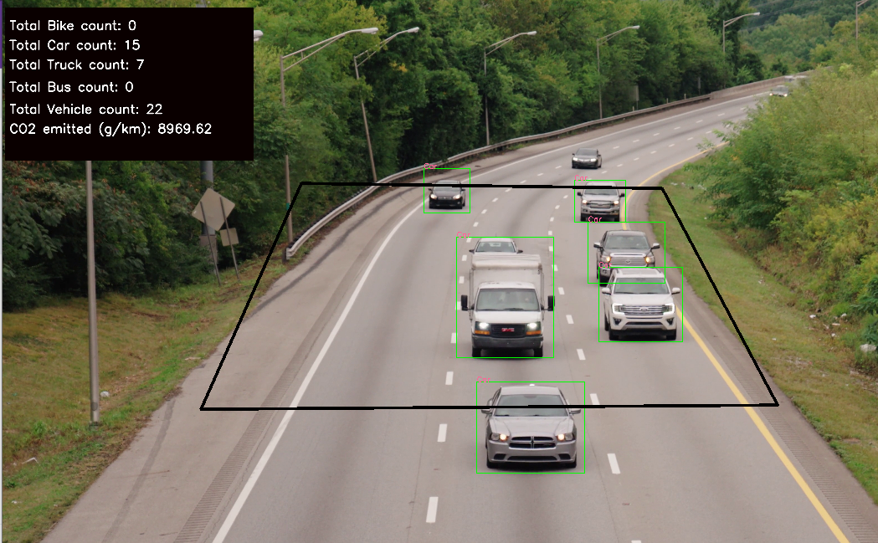
PS3 - Output

Slide 18
Conclusion
PS-1: Parking lots filled or empty
PS 2: Traffic Count
PS 3: Pollution

Slide 19


Slide 20

THANK YOU

